Slide 1
CS 5402 Introduction to Data Mining
Data Mining Methods - Agglomerative Clustering
v.1.0
Perry B. Koob, koobp@mst.edu

Slide 2
What we are going to learn.
Agglomerative Clustering

Slide 3
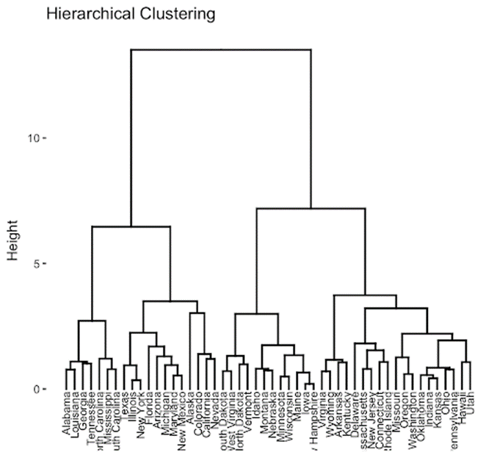
Dendrogram

Slide 4
Distances
We treat each example as a cluster of one.
Then we start forming linkages between two clusters, one at a time.
The linkages are based off of the distance between the examples, and a linkage function.

Slide 5
Linkage Functions.
Linkage Function
Single Linkage | The shortest distance between the points in each cluster.
Complete Linkage | The Longest distance between the points in each cluster.
Average Linkage | The Average distance between all points in one cluster to all points in the other.
Ward’s Method Linkage | The minimize the sum of squared differences between all clusters.

Slide 6
Linkage Functions.
Linkage Function
Single Linkage | The shortest distance between the points in each cluster.
Complete Linkage | The Longest distance between the points in each cluster.
Average Linkage | The Average distance between all points in one cluster to all points in the other.
Ward’s Method Linkage | The minimize the sum of squared differences between all clusters.
For this example I am going to use the Single Linkage.
The Linkage functions will not appear to be as important for the first join, but it will make sense as we get more cluster members.

Slide 7
Distances
We calculate the distances between each example and place it in a distance matrix.
May also be called a proximity matrix.

Slide 8
Distances
We calculate the distances between each example and place it in a distance matrix.
The distances are calculated using the same distance functions we used for k-Nearest Neighbor, and k-Means clustering.
Manhattan distance,
Euclidian distance,
Mahalanobis distance…

Slide 9
Distances
We calculate the distances between each example and place it in a distance matrix.
The distance matrix is square, M x M given M examples.
Normally represented with a Lower Triangular matrix because of duplication. The distance between A and C is the same as C and A.
The diagonal is all 0, because the distance A is from itself is 0.

Slide 10
Distances
We find the two closest clusters, remember these are clusters of size one, using out linkage function and we join the two together.
The distance between C and E is 1. So we join those clusters.

Slide 11
The First Merging of Clusters
We find the two closest clusters, remember these are clusters of size one, using out linkage function and we join the two together.
The distance between C and E is 1. So we join those clusters.
Note the distance, that is going to be the level of the clusters in our dendrogram.

Slide 12
The First Merging of Clusters
We find the two closest clusters, remember these are clusters of size one, using out linkage function and we join the two together.
We add out newly created cluster to the end of the list of clusters.
We determine the distance of the new cluster from the other clusters and update our distance matrix. This will be base on the Linkage chosen.
Since we are using Single Linkage, we will choose the shortest distance between the new cluster and the old cluster.
So we can now create

Slide 13
New Distances
Now we remove the old matixes from the distance matrix.

Slide 14
Dendrogram
Now Lets take a look at out dendrogram.
Level 1 was set because we started at Level 0 and added the distance.
Level 1
A
B
C
D
E

Slide 15
Second Merging of Clusters

Slide 16
Second Merging of Clusters

Slide 17
Dendrogram
Now Lets take a look at our dendrogram.
We were at Level 1 and added the distance the new clusters were from each other. So we have Level 3.
Level 3
Level 1
A
B
C
D
E

Slide 18
Third Merging of Clusters
We have a tie So we merge the ties.

Slide 19
Dendrogram
Now Lets take a look at our final dendrogram.
Level 6
Level 3
Level 1
A
B
C
D
E

Slide 20
What we covered.
Agglomerative Clustering

Slide 21
References
Witten, I. H., Frank, E., Hall, M. A., & Pal, C. J. (2016). Data Mining: Practical Machine Learning Tools and Techniques.

